Slide 1


MapReduce vs Apache Spark
S.P.D.D. Ariyaratne (248207U)

Slide 2
MapReduce
Programming model, and framework for processing and generating large datasets in a distributed environment
Map Phase
Reduce Phase
Input data will be divided into key-value pairs.
Process data in parallel across multiple nodes to produce intermediate key-value pairs.
Intermediate key-value pairs will be combined and reduced to produce the final output.

Slide 3
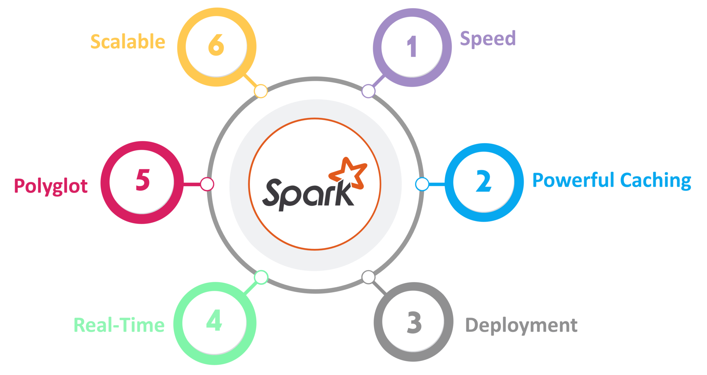
Apache Spark
Open-source distributed processing system used for big data workloads.
Spark is built on top of the Hadoop distributed file system.
Use of Resilient Distributed Datasets (RDDs)
Utilizes in-memory caching, and optimized query execution, for fast analytic queries against data of any size.
It is designed to be fast, and also provides APIs for multiple programming languages such as Scala, Java, Python and R.

Slide 4
Demonstration

Slide 5
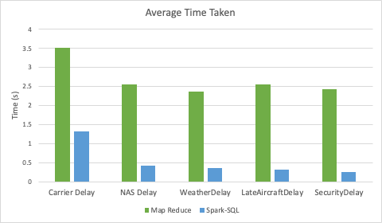
Compare and Contrast
 | MapReduce | Apache Spark
Ease of Use | Simple and easy-to-use framework which uses for batch processing of large data sets. | Provides higher-level programming model that makes it easier for developers to work with large data sets.
Fast Processing | Processes data by reading from disk for each MapReduce job and writing intermediate results back to disk, hence more time is taken to execution of the queries. | As a result of in-memory processing capabilities, faster than MapReduce.

